Slide 1
Handling Imbalanced Data for Classification

Slide 2
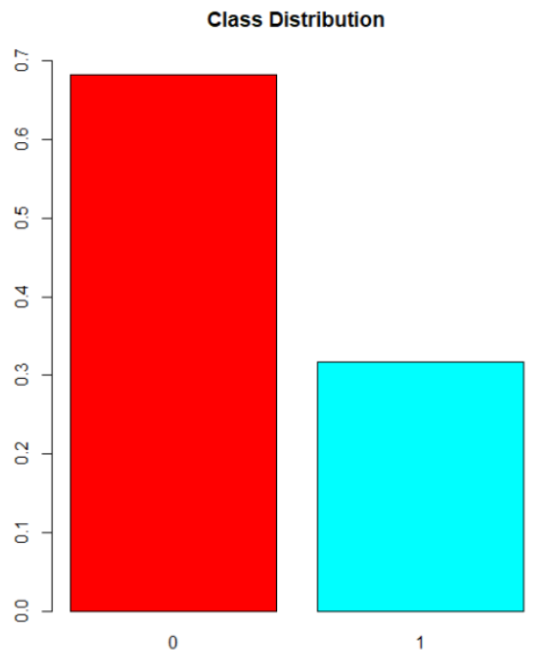
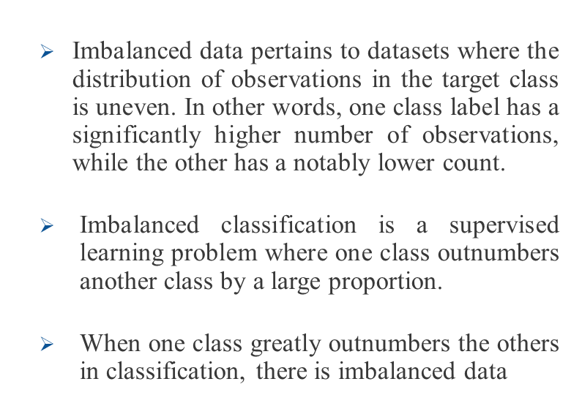
What is Imbalanced Data?

Slide 3
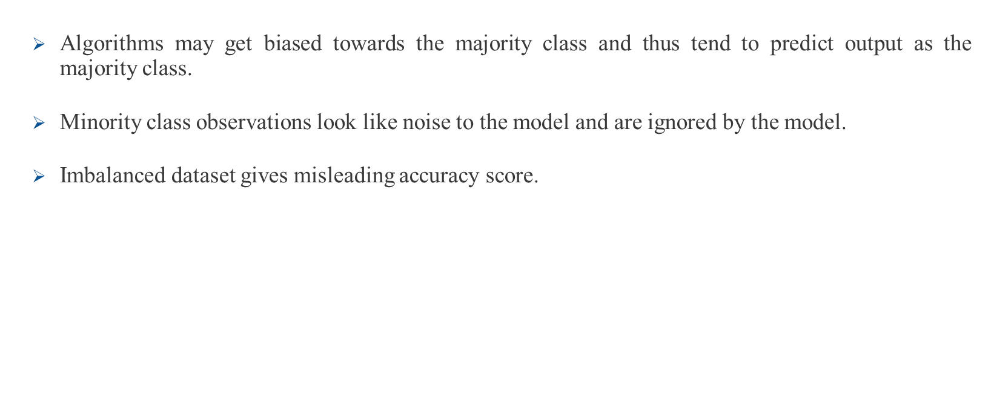
Problem with Handling Imbalanced Data for Classification

Slide 4
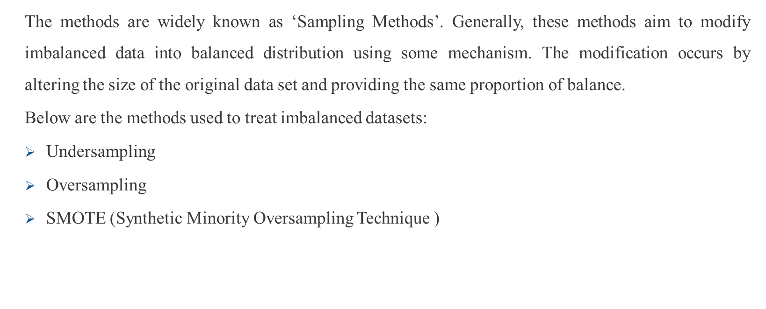
Ways to Handle Imbalanced Data for Classification

